Slide 1
UNIT 3
USABILITY FOCUSED PROJECT DEVELOPMENT

Slide 2
Redesigning App/Website using design lifecycle
https://blogs.zeiss.com/digital-innovation/en/usability-in-software-development-projects/
There are series of steps that can make the redesign experience less painful and more likely to result in a positive outcome for both the user and the business.
Step by step process:
Understand initial goals of redesigning
Communicate with users to gain insights
Evaluate customer reviews and feedback
Implement changes and user experience
Test redesign with users
Monitor and maintaining

Slide 3
1. Understand initial goals of redesigning
Is it time to redesign because user experience trends have changed?
Is it time to redesign because you launched a new feature?
Is it time to redesign because the competition is providing a better app experience?

Slide 4
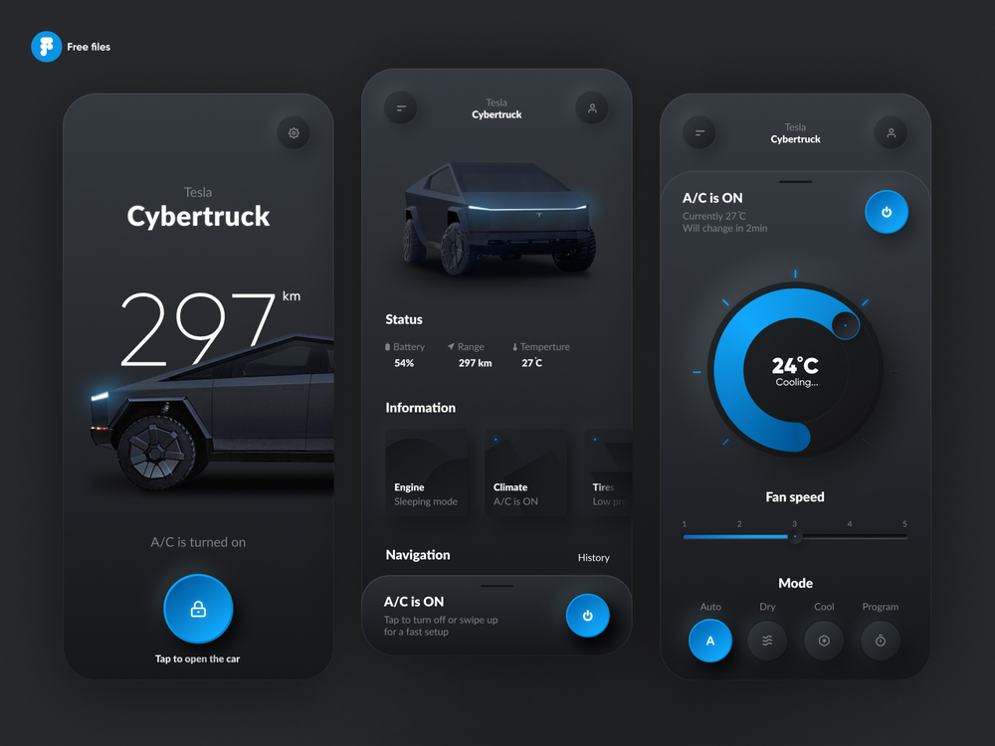

Slide 5
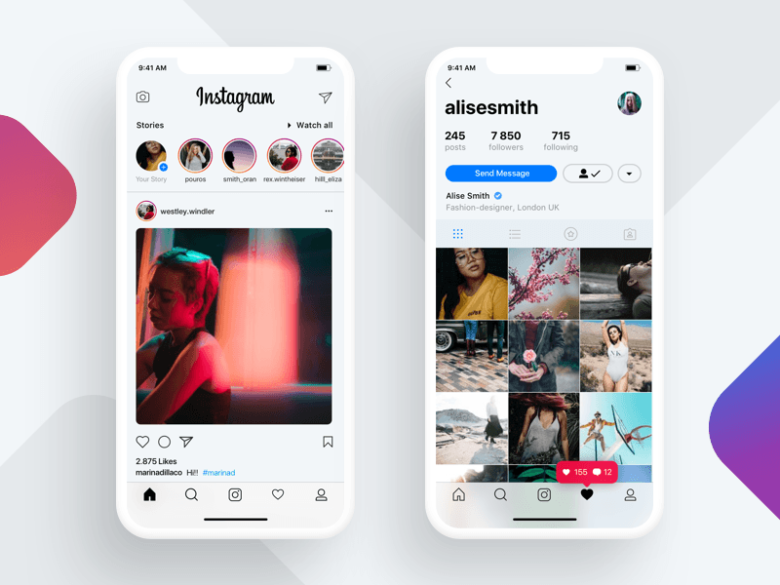

Slide 6
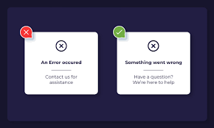

Slide 7
Step 2: Communicate With Users To Gain Insight
One of the most underestimated steps in the redesign process is communication.
At this stage, you already know exactly what you want to accomplish with your app redesign.
Now you have to communicate the impending change to people who love and frequently use your website/app.
Once you’ve communicated this, you can meaningfully engage your users and learn what they do and don’t like about the current experience or what they’d like to see changed.

Slide 8
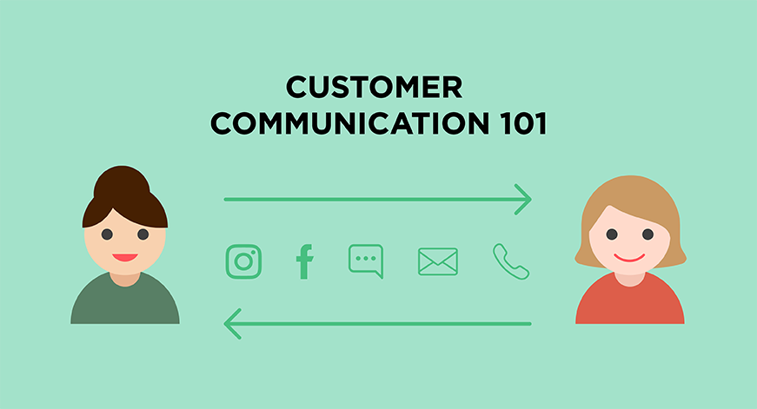

Slide 9
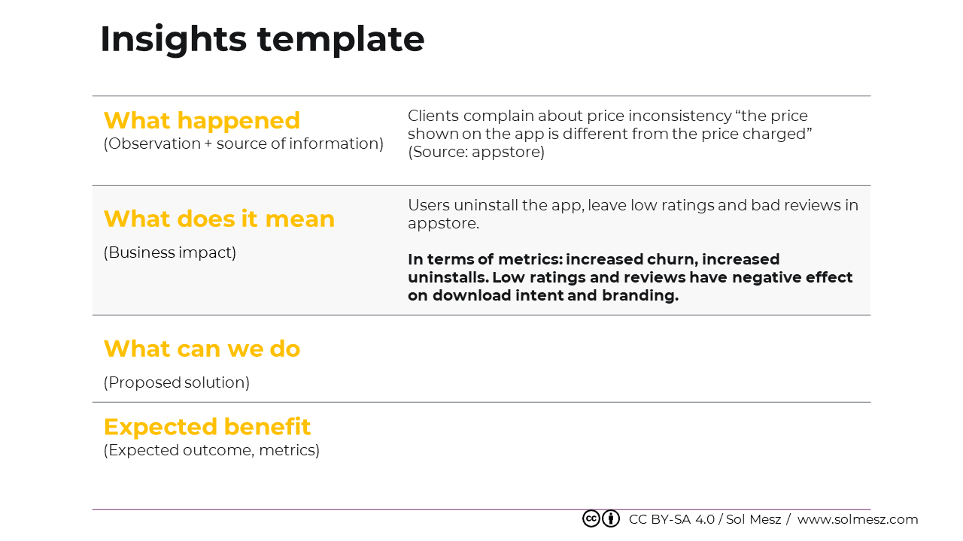

Slide 10
Step 3: Evaluate Customer Reviews & Feedback
If your app has been in the hands of real people for a few months, it’s likely that you have data.
Some of this data will be quantitative (e.g., stats on in-app usage and engagement) while some will be qualitative (e.g., reviews and messages).
Compile all this data and look for trends.
Do you notice that lots of users are complaining about a specific feature? Are users asking how to update a specific element of their account? Are users tapping a specific button when they’re trying to select something else?

Slide 11
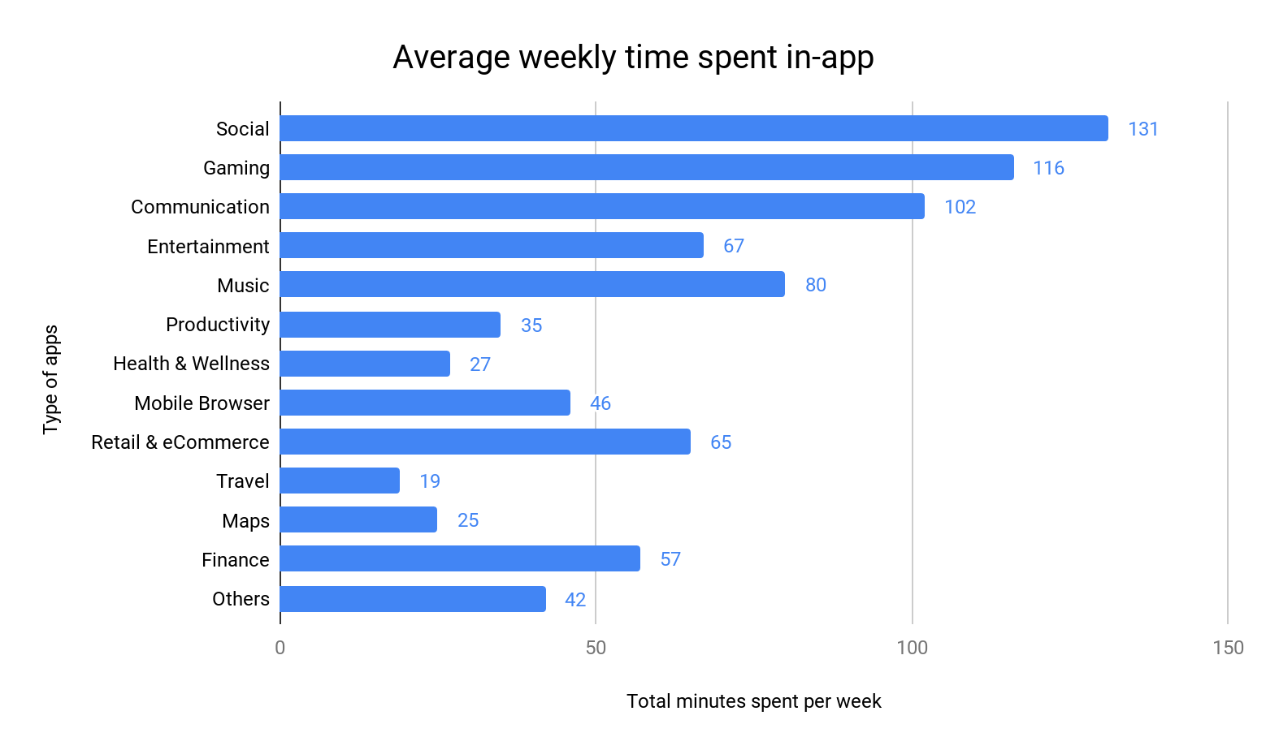

Slide 12
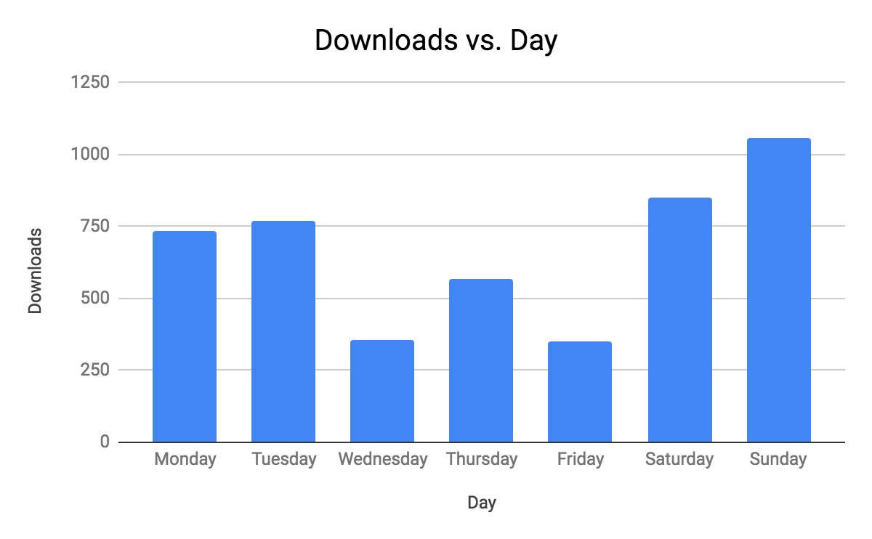

Slide 13
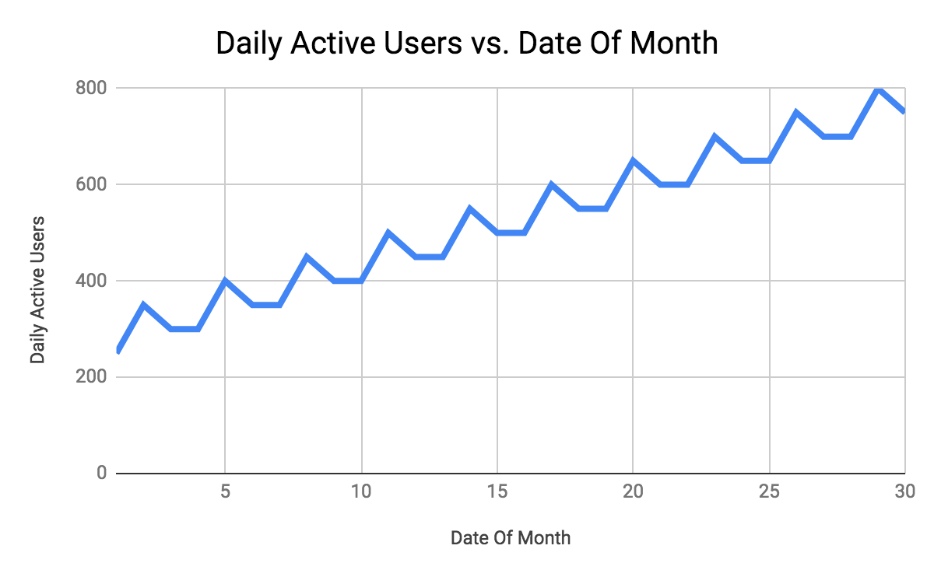

Slide 14
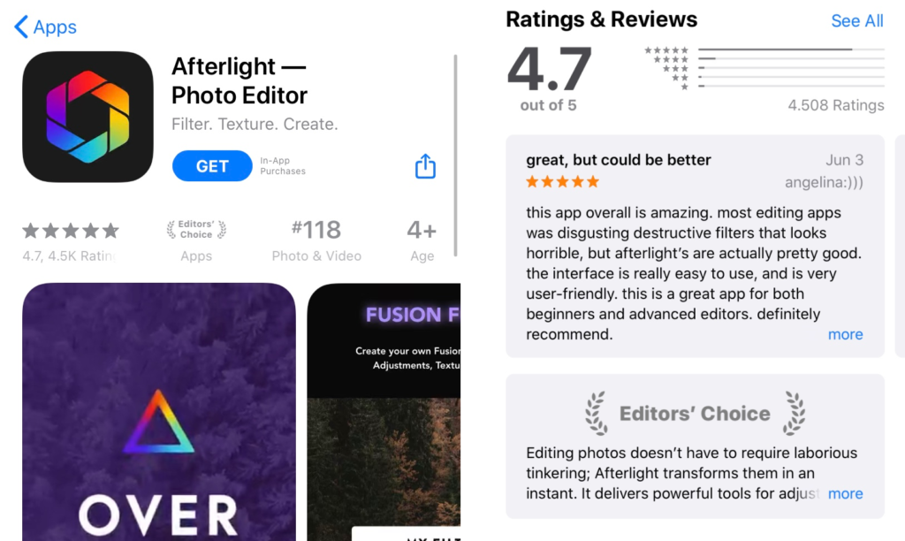

Slide 15
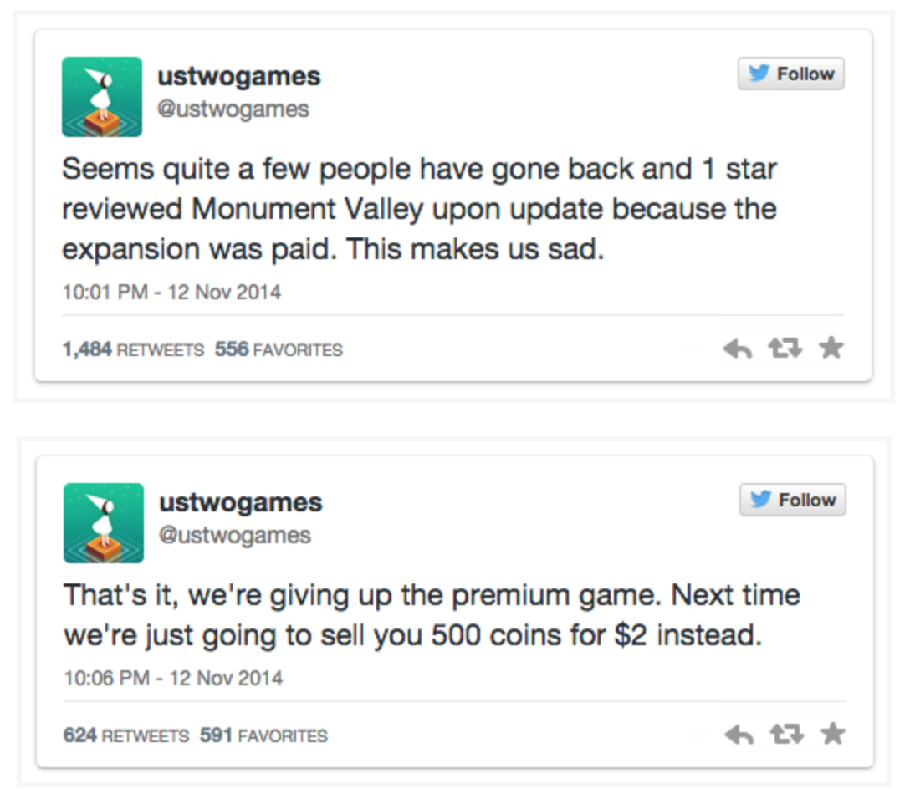

Slide 16
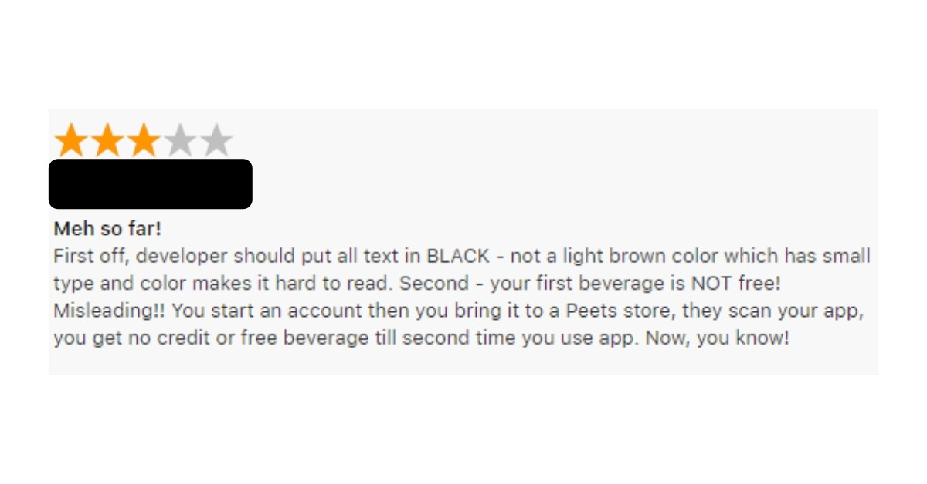

Slide 17
Step 4: Implement Changes To The Look & The User Experience
As per the quantitative and qualitative data collected ,an analysis is carried out for the essential changes that need to be redesigned in the application.
Make appropriate decisions to implement the necessary changes in stages.

Slide 18
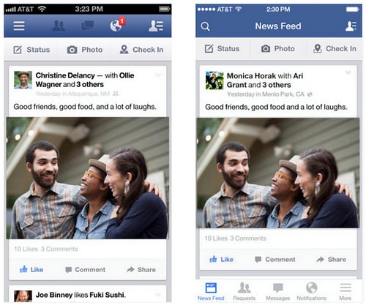

Slide 19
Step 5: Monitor Usage & User Response Upon Launch
To find out if the redesign was successful, look back at the goal you set out when you first started this project and gauge whether you achieved it.
Did usage increase? Did engagement increase? Are there more positive reviews in the app store than there were before? Are you seeing a spike in growth?
That’s where you need to focus your attention now. Use your data and feedback as a starting point to not only gauge whether the redesign was a success but also to uncover opportunities to iterate and improve.

Slide 20
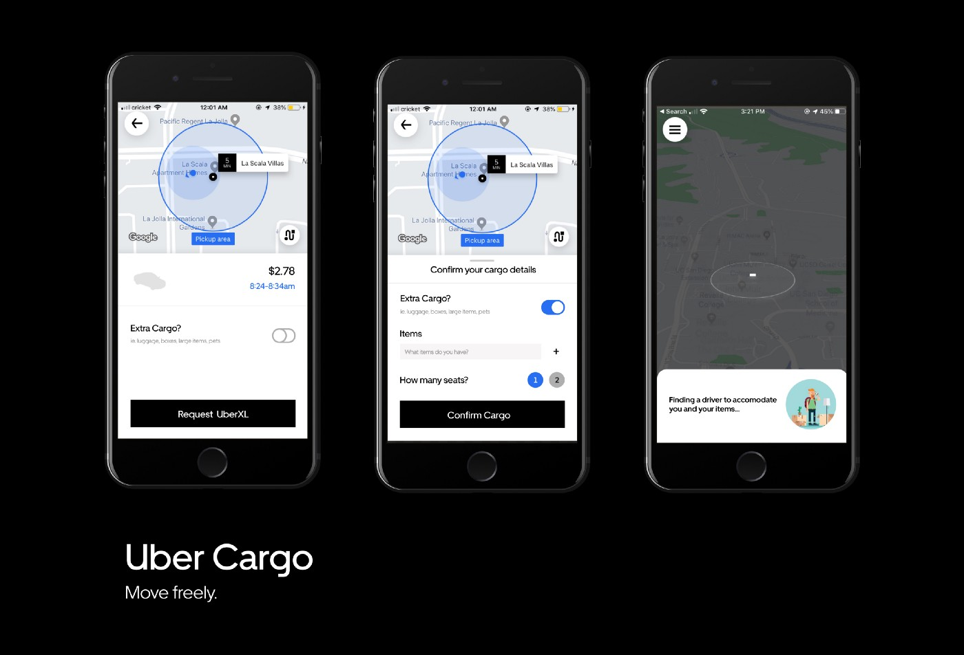
Uber underwent their most recent redesign

Slide 21
Case study 1-UBER
https://medium.com/@katyanoble/uber-redesign-case-study-44349274da2a

Slide 22
Case Study 2 -GXpress
https://uxplanet.org/gxpress-website-redesign-ux-case-study-56dbbd067824

Slide 23
Usability Testing
Usability testing refers to evaluating a product or service by testing it with representative users.
Typically, during a test, participants will try to complete typical tasks while observers watch, listen and takes notes.
The goal is to identify any usability problems, collect qualitative and quantitative data and determine the participant's satisfaction with the product.

Slide 24
The goal of this testing is to satisfy users and it mainly concentrates on the following parameters of a system:
The effectiveness of the system
Is the system is easy to learn?
Is the system useful and adds value to the target audience?
Are Content, Color, Icons, Images used are aesthetically pleasing?
Efficiency
Little navigation should be required to reach the desired screen or webpage, and scrollbars should be used infrequently.
Uniformity in the format of screen/pages in your application/website.
Option to search within your software application or website.
Accuracy
No outdated or incorrect data like contact information/address should be present.
No broken links should be present.
User Friendliness
Controls used should be self-explanatory and must not require training to operate
Help should be provided for the users to understand the application/website
Alignment with the above goals helps in effective usability testing

Slide 25
Benefits of Usability Testing
Usability testing lets the design and development teams identify problems before hand.
The earlier issues are identified and fixed, the less expensive the fixes will be in terms of both staff time and possible impact to the schedule. During a usability test, you will:
Learn if participants are able to complete specified tasks successfully and
Identify how long it takes to complete specified tasks
Find out how satisfied participants are with your Web site or other product
Identify changes required to improve user performance and satisfaction
And analyze the performance to see if it meets your usability objectives

